Slide 1

MS Fabric BoC Architecture
BOC deployment architecture
Bank of Canada - 2025

Slide 2




Levels in a MS Fabric deployment
Fabric deployment has four levels: Tenant, capacity, workspace & item.
Each tenant can have one or more capacities, each capacity can contain one or more workspaces, and each workspace can contain zero or more Fabric items.
A domain is a “logical grouping” of workspaces independently of the capacity assigned to them
Power BI Shared Capacities (Pro) are managed from the Fabric Tenant level
Fabric Tenant
Capacity
Capacity
Domain
Client X
Workspace(s)
lakehouse
Use domains for implementing data mesh and managing and governing data in the scope of a business domain composed by multiple workspaces.
Use workspaces as boundaries for data transformation stages, governance, and security.
Use capacities to scale or to isolate compute resources and to achieve flexibility in tenant configuration governance model from centralized model to federated model
warehouse
eventhouse
Domain
Client Y
Workspace(s)
lakehouse
warehouse
eventhouse

Slide 3
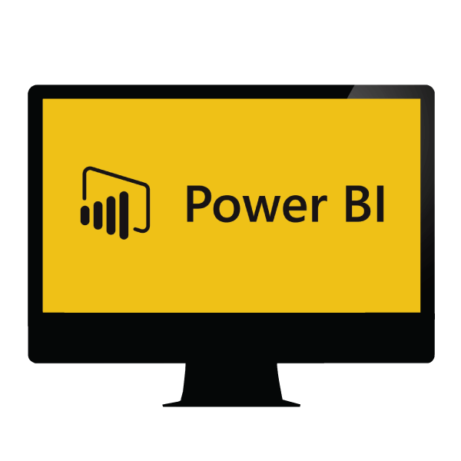
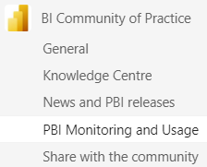
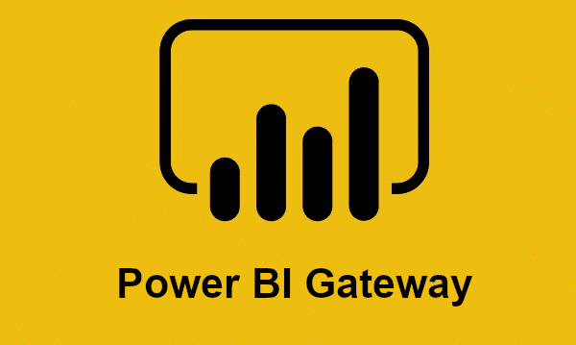
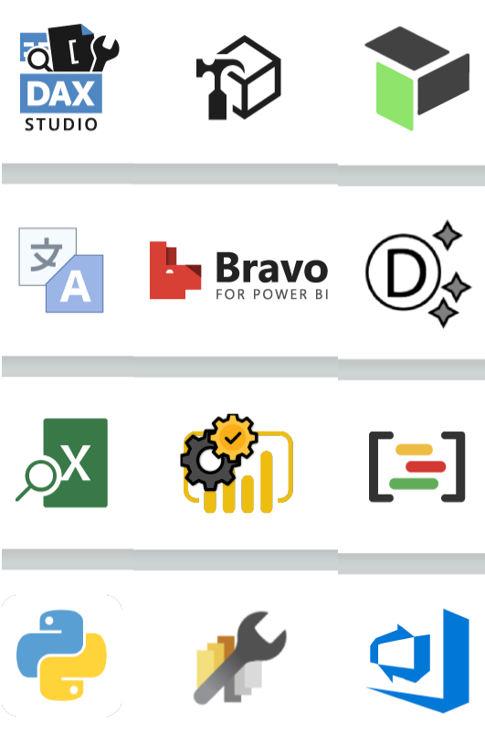







BoC MS Fabric ALL components
(multiple Azure tenants )
BOCAD Fabric Tenant
CAPACITY 1
(F-128 SKU)
CA & Ops Domain
CAPACITY 2
(F-128 SKU)
Analytic AE Domain
PBI PRO CAPACITY
(SaaS Shared Capacity)
BoC BI Self-service
Power BI Tools
(Apps on users’ laptops)
BI Community of Practice
(BI Self-service Support)
Power BI
Data Gateway
(Cluster on Azure VMs)
MS Teams
User Data Domain
(HR, Cyber, FER…)
User Data Domain
(Delphi, ECP/FSS)
User Data Domain
PBI Desktop
( 350 users)
Data Domain (IMPACT)
User Data Domain (TRITON)
Workspaces
Workspaces
Workspaces
Lakehouse
PBI External Tools
(12 tools in use)
Lakehouse
Warehouse
BI data and reports
Warehouse
ML Model
4 VMS in Azure BOCAD
98 Data connections
ML Model
BI report
BI report
225 members
Support channel for BI self-service
Bi-weekly meetings
Best Practices, policies and guidance
BOCAD OneLake data lake
Onelake Explorer
PBI PRO CAPACITY
BoC EXTERNAL
PBI PRO CAPACITY
BoC QA
PBI PRO CAPACITY
BoC DAZ

Slide 4

BoCAD Fabric Tenant Capacities Architecture
SEPARATE Capacities based on type of Data, Business Process and client needs
BOCAD Fabric Tenant
CAPACITY: Corporate Administration
(F-128 SKU)
CAPACITY : Analytical Environment
(F-128 SKU)
CAPACITY: BoC BI Self-service
(SaaS Shared Capacity)
CA Business User Domain
AE Business User Domain
Workspaces
Workspaces
Workspaces
lakehouse
lakehouse
BI data and reports
warehouse
warehouse
BI report
BI report
AE Business User Domain
CA Business User Domain
Workspaces
Workspaces
Workspaces
BI data and reports
lakehouse
lakehouse
warehouse
warehouse
BI report
BI report
Self-serve Business User Domain
Workspaces
BOCAD OneLake data lake
BI data & reports
SaaS Data storage

Slide 5
BoCAD Fabric Tenant Admins levels
Tenant Administration Level:
Configure and manage organization-wide settings for:
  Fabric F Capacities
  PBI Pro Capacity
  PBI Tools
Manage PBI data gateways Infrastructure
BOCAD Fabric Tenant
Fabric Data Gateways (Cluster on Azure VMs)
PBI & Fabric
Desktop Tools
Fabric Capacity Administration Level:
Capacity usage monitoring. ( average and bursting)
Capacity and Data Solutions performance tunning
Configure delegated Tenant settings
Provisioning workspaces.(automated)
CAPACITY F-128:
CA & Ops Domain
CAPACITY F-128:
Analytic (AE) Domain
Business Domain A
Business Domain X
Workspaces
Workspaces
Domain Administration Level:
Configure domain-specific settings
Associate workspaces with domains
Ensure domain-level Data compliance
lakehouse
lakehouse
warehouse
warehouse
ML experiment
ML experiment
BI report
BI report
Workspace Admin:
Manage assigned Workspace.
  Assign Roles and Permissions.
  Manage Content
Ensure Data Security within the workspace.
Monitor Usage and Performance
Workspaces
BI data and reports
Workspaces
BI data and reports
PRO Shared Capacity is a SaaS managed by MS, Tenant settings apply directly
CAPACITY PBI PRO:
BoC BI Self-service

Slide 6
BOCAD Fabric Admins levels - draft
CA Fabric Capacity Administration:
DDO CA
Tenant Administration: Louis Bergeron ITS
AE Fabric Capacity Administration: DDO AE
Tenant Platform mgmt.
Tenant Capacity mgmt.
BoC Fabric Tenant
Tenant Capacity mgmt.
Power BI & Power Platform Data Gateways
CAPACITY F-128:
CA & Ops Domain
BOCQA
Capacity PBI PRO
DAZ
Capacity PBI PRO
BOC External Capacity PBI PRO
Desktop Tools
CAPACITY F-128:
Analytic (AE) Domain
CAPACITY PBI PRO: BoC BI Self-service
CA Business Domains
Personal BI Self-service
AE Business Domain(s)
Lakehouse(s)
BI report
BI report
BI report
Lakehouse(s)
Business Data Products Mgmt.
BI Self-service
BI Self-service
Business Data Products Mgmt.
Domain Administration:
CA Business Departments
Domain Administration:
AE Business Departments

Slide 7
BoCAD Fabric Admins levels – Main Support Processes
MS Purview integration with Fabric will enhance the Data Product life cycle mgt. and the Data quality and governance in general.
Business Domains must be created considering a they will be part of an Organization hierarchy for applying governance and monitoring policies at different granular levels.
BoC Fabric Tenant Level
Tenant Global configuration and support.
Tenant Global Performance and Usage Mgmt.
Fabric CAPACITY Level
Tenant Level New features Assessment ( Cyber, ATIP )
Tenant Domain Provisioning.
Business Domains Level
Tenant Data Gateways Infrastructure
Capacity configuration and support.
Tenant Data Tools life cycle and assessment
Capacity Usage Monitoring.
Tenant Data Architecture for Platform and Data Solutions support
Capacity workspace creation
Capacity Disaster Recovery
Capacity New features Assessment ( Cyber, ATIP )
Capacity Performance and Usage Mgmt.
Workspace and Data administration.
Data Gateways Connections mgmt.
Data Products Development life cycle mgmt.
Legend:
Support Process with COORDINATION between multiple Administration levels

